Slide 1
Winter Pressures Update
Lisa Henschen, Managing Director on behalf of the Harrow Borough Based Partnership

Slide 2
The Harrow Borough Based Partnership
Harrow Borough Based Partnership brings
together our NHS organisations, Harrow Council,
our GPs, and local Voluntary & Community Sector.
We strive to support each
other and our communities as
equal partners focussing on
better health and wellbeing for all.
NHS North West London Integrated Care System
Harrow Council
Harrow’s Primary Care Networks
NHS Central London Community Healthcare NHS Trust
NHS Central and North West London NHS Foundation Trust
NHS London North West University Healthcare
Harrow Together
Harrow Health Community Interest Company
St Luke’s Hospice

Slide 3
Summary position: winter pressures
Demand pressure during the winter of 22/23, in terms of both the number of people requiring health and social care provision and the complexity of their needs, is extremely high and is challenging the capacity of health and social care systems to provide appropriate care.
ONS data shows that between 2011 and 2021 Harrow’s population increased by 9.3%, compared to an average increase for London of 7.7%.
This increase in population, which includes a rapidly growing number of older people, is contributing to pressure on all parts of the care system.
Acute Care (Northwick Park Hospital)
  Continued high volumes of A&E attendances either by ambulance or walk ins (see slide 4). Northwick Park Hospital (NPH) continues to receive the highest number of ambulances and blue light attendances across all of London which places pressure on handover (See slide 5)
  NPH routinely starts the day with more patients waiting for admission than there are available beds, illustrated by the increasing levels of escalation at the hospital (see slide 6)
  Continued pressure on adult mental health attendances and children with complex social issues remaining in A&E for significant periods of time
  Recent impact of industrial action across system partners
Primary Care and Community Nursing in Harrow
The potential to meet increased demand through improvements in the productivity of primary care is limited by severe constraints on the expansion of the primary care estate.
The primary and community care workforce also has substantial vacancies (see slide 9)
Social Care Pressures
For every patient that no longer requires a long term care package in the community there are 2.8 new packages required.
71% increase in the number of support requests for new people resolved on average each week (community route) since March 2020
The number of ongoing support requests being handled for new clients from the community has increased by 66% since March 2020.
The number of ongoing support requests being handled for new clients from the hospital has increased by 253% since March 2020.

Slide 4
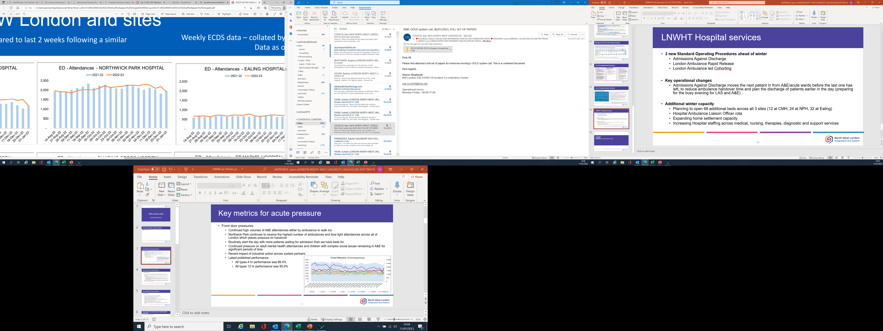
ED attendances – Northwick Park

Slide 5
Total weekly conveyances: North West London

Slide 6
Northwick Park Hospital Escalation Status

Slide 7
Discharge pathway
Improving the Discharge Pathway
  As we move into winter our length of stay has increased. We have seen an increase in admissions for Flu, Covid, RSV which require separate bedded pathways, placing pressure on bed flow
  LNWHT remain positive under the regional average for inpatient length of stay indicators
  To support flow we have in place:
    Complex Discharge Team working with system partners including Harrow voluntary services
    Expanded our Discharge lounge at Northwick Park to include a new areas for patients recovered from infectious diseases
  Across the sector the key reason for delays with medically fit for discharge patients still in an acute bed over 21 days are pathway 3 patients where patients are awaiting availability of a bed in a residential / nursing home

Slide 8
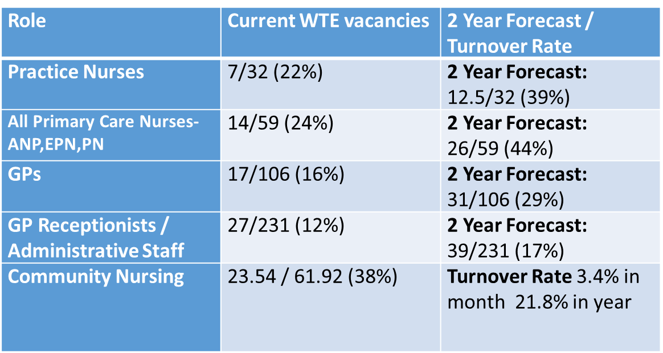
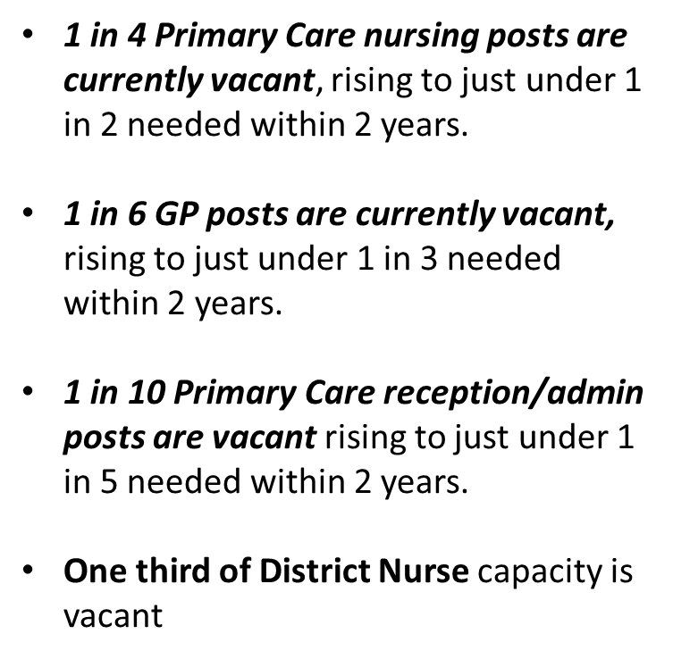
Key metrics for Primary Care and Community Nursing Workforce Pressures

Slide 9
Health and Care system response

Slide 10
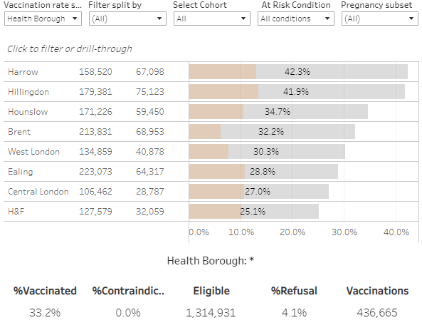
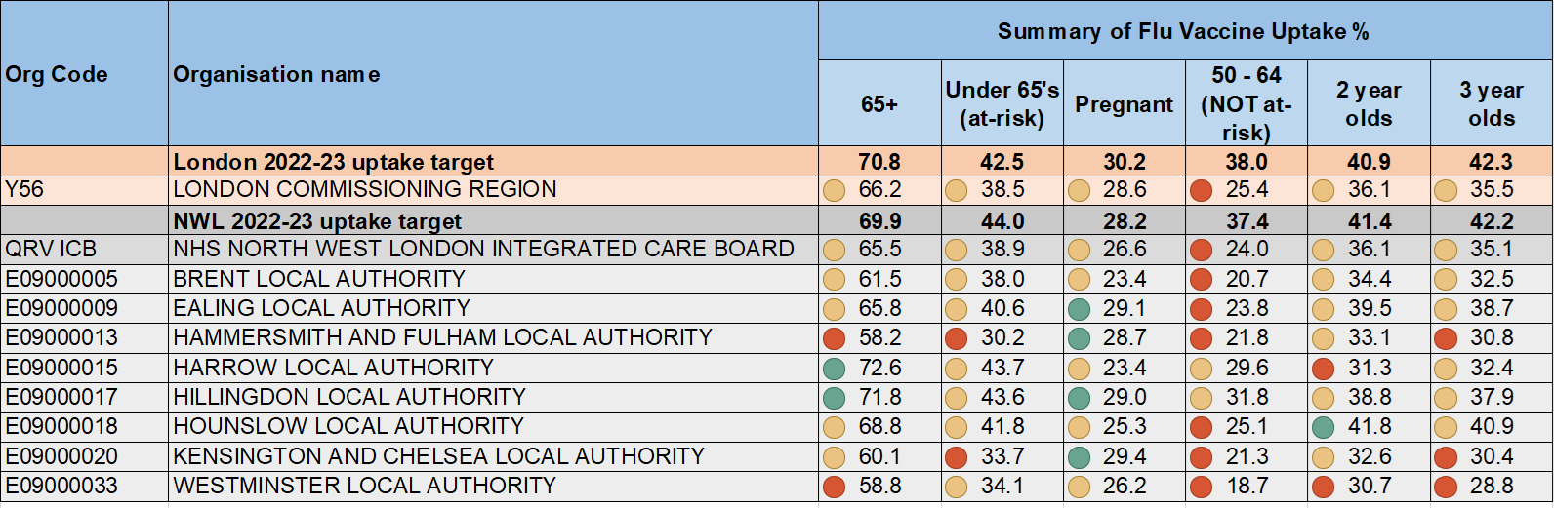
NWL Flu vaccination uptake 03.01.2023 and Harrow Borough rates by cohorts

Slide 11
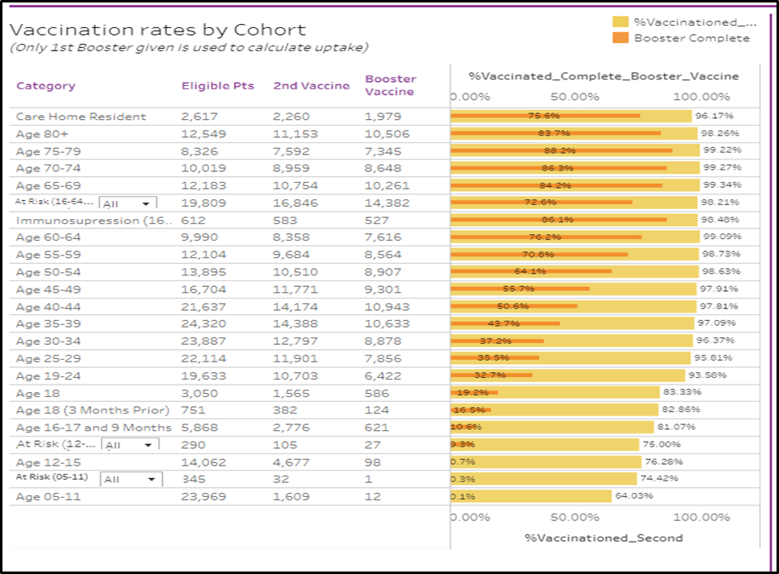
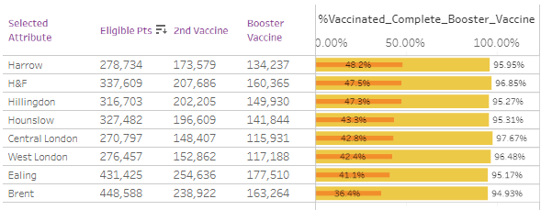
NWL COVID uptake and Harrow Borough rates by cohorts (10.01.2023)

Slide 12
Wellbeing in Winter
MECC is the opportunity to do something fast that prevents ill health
Eat Heat Beat
Have a daily hot meal, drink at least 6/8 cups of fluid a day
Know what you are entitled to, be careful of fire risks, layer up your clothing
Where to get help. Vaccinate. What is happening in the community. Keep talking and moving
Making Every Contact Count programme
Winter messages
Open to all staff in LA, NHS and the CVS
Links to other initiatives
Sources of information: SHINE, SWISH, Help Harrow, CAB Harrow, Turn2Us

Slide 13
Implementation of NWL winter response with additional funding
Provider | Allocation & purpose | Current position
London North West University Hospital Trust | £2,195,000: Physical Beds | Increased winter bed base to plan of 68 beds (24 at NWP)
London North West University Hospital Trust | £337,000: Discharge Flow initiatives | Expanded discharge lounge across sites to support winter flow Expanded flow model (additional patients on wards) Expanded LAS led cohorting in A&E corridor Partnering with LAS for Hospital Ambulance Liaison Officer rota in A&E Continue with daily review of the LAS flow model for redirections of ambulances during periods of high volumes of conveyances Partnering with Voluntary Sector for home settlement services Planning to expand SDEC to an overnight service in January Planning to expand the Single Point of Access for primary care and ambulance referrals in January

Slide 14
Implementation of NWL winter response with additional funding
Provider | Allocation & purpose | Current position
Primary Care | £72,818: Additional GP appointments | The service commenced in October and is on track to deliver 3020 additional appointments by 31 March
 | £159,523: Paediatric Hub | The service commenced in December in response to the increased demand and attendances driven by Strep A Virus and Flu in children
CLCH | £100,000: Rapid Response Increase to Rapid Response staffing to deliver an increase in patients supported from A&E. To increase by 14 complex patients per month. | Commenced Dec 2022. Utilising bank staff to achieve. Not available every day resulting in gaps. Agency requests made.
CLCH | £90,000: P2 Rehabilitation Bed capacity up to 19. To deliver phased increase of beds. To commence with opening 6 beds Feb 2023. | Commence Feb 2023. Delivery plan in place. Staffing remains a risk to achieve 19 beds.

Slide 15
Implementation of winter response with additional funding
Scheme Name | Provider | Financial Allocation (total for scheme | Purpose | Progress to date
Expanded Support to Discharged Patients / Weekend Support | Harrow Together | £138,100 | Expansion of Harrow Together Discharge Support, including transport, home cleaning, support in paying bills etc - existing service at full capacity. | Recruitment and training complete. Additional staff starting full shifts from 10/1/23.
 | Central London Community Healthcare Trust (CLCH) |  | Home First: Expansion of D2A packages from 3 to 5 days | There have been on average 5 additional D2A referrals for therapy since 03/01/23.
 | Central North West London NHS Trust (CNWL) |  | Mental Health Reablement: additional packages of care to facilitate D2A provided by Hestia / Care Compassion. Target 24 referrals per month Jan-March. | Service will commence in January. 4 referrals accepted w/c 2/01/2023- 3 facilitated early discharge, 1 avoided admission.
 | London Borough of Harrow |  | Social Care Post-discharge Support capacity | The service has commenced without any issues at present.
Increased Capacity for Adult Social Care Reviews | London Borough of Harrow | £78,900 | Increase capacity of LA Community Review Process, in Promoting Independence Team / NPH AED, including, potentially, seven day working. | The service has commenced without any issues at present.
Falls: Strength and Balance Training / Prevention | Harrow Together | £78,900 | Strength and Balance Training and Falls Prevention | First cohort of 25+ participants recruited for sessions starting 03/01/23.
 | London Borough of Harrow
 |  |  | Strength and Balance Training for people at risk of falls. | The service has commenced without any issues at present.
Additional 7 Day Social Work On Site Hospital Support | London Borough of Harrow | £51.454 | Reduced P1 and P3 delays- faster weekend support

Slide 16
Implementation of winter response with additional funding
Scheme Name | Provider | Financial Allocation (total for scheme | Purpose | Progress to date
Harrow Winter Wellness programme | London Borough of Harrow | £282,000 | Harrow winter wellness programme: health and wellbeing programmes through Harrow warm hubs | Programme commenced end of December. Health checks commencing w/c 9th January
 | Central London Community Healthcare Trust (CLCH) | £8,000 | Delivery of health checks in warm hubs
Vaccine Hesitancy | TBC | £30,000 | Address COVID and Flu vaccination hesitancy in unvaccinated cohorts | Procurement in progress

